Slide 1
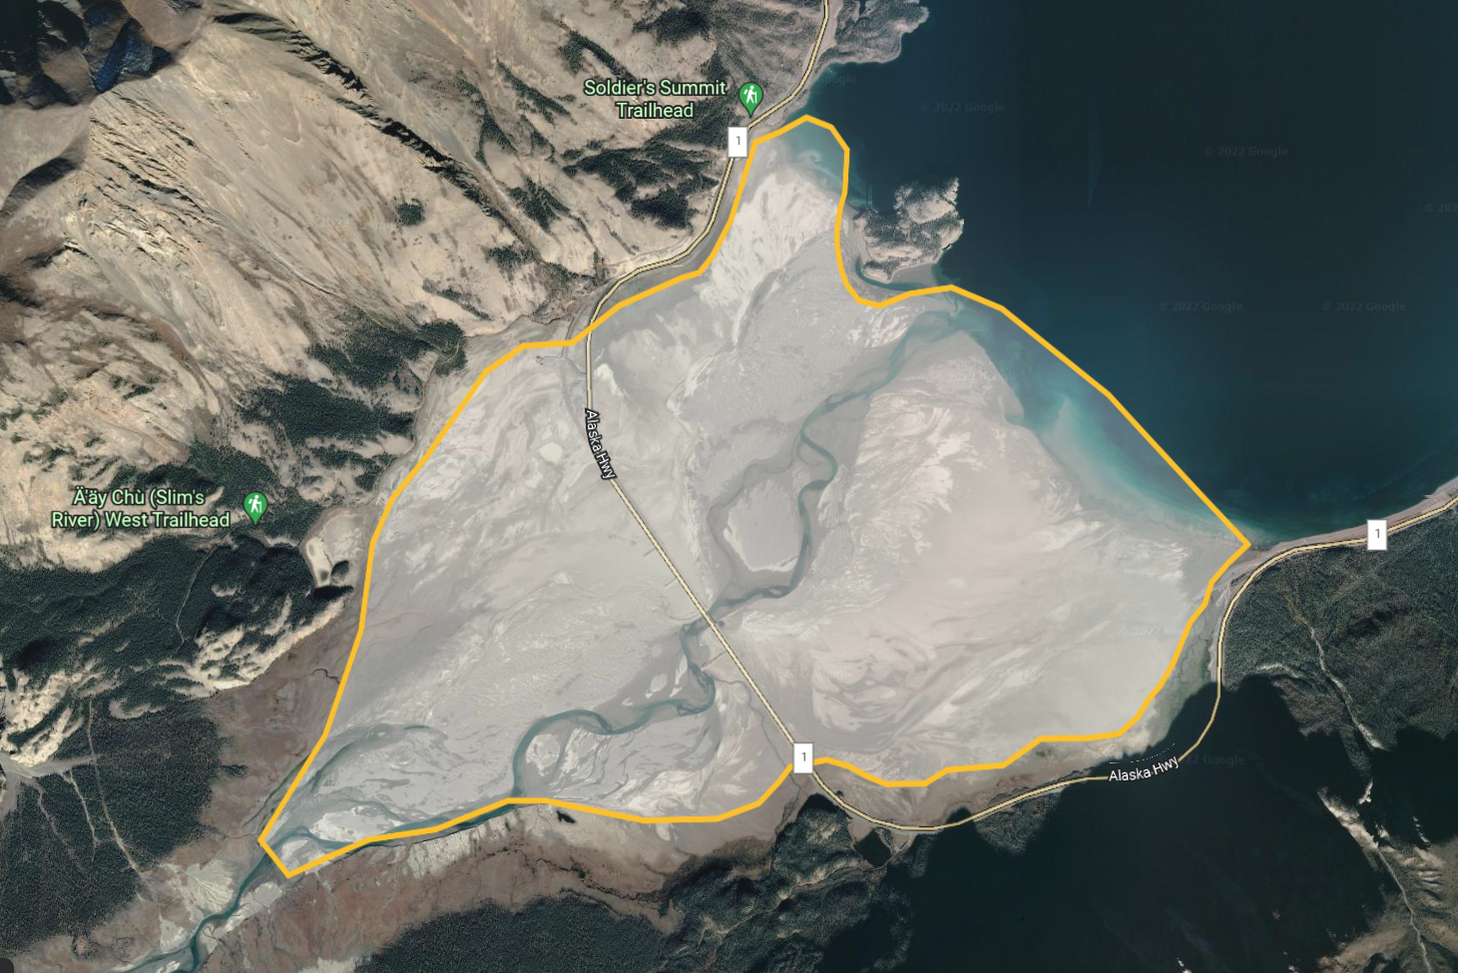
Figure 1

Slide 2
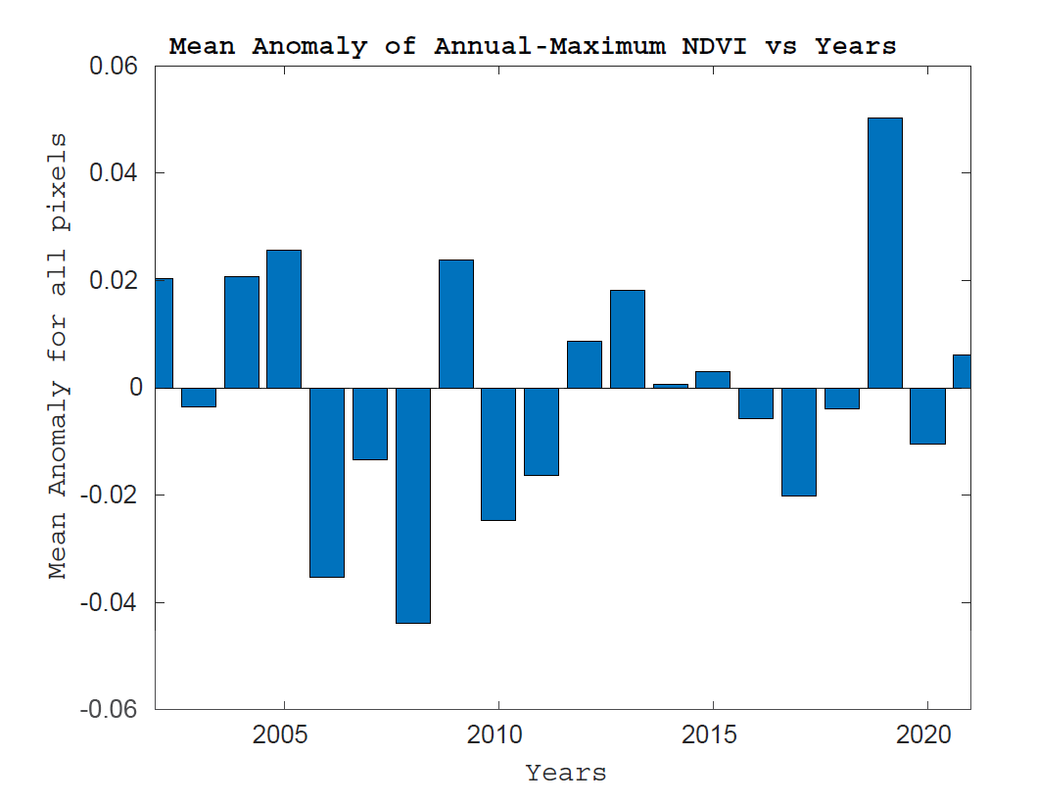
Figure 2
Code Location: Codes/Entire_year_NDVI/Entire_Region.mlx

Slide 3
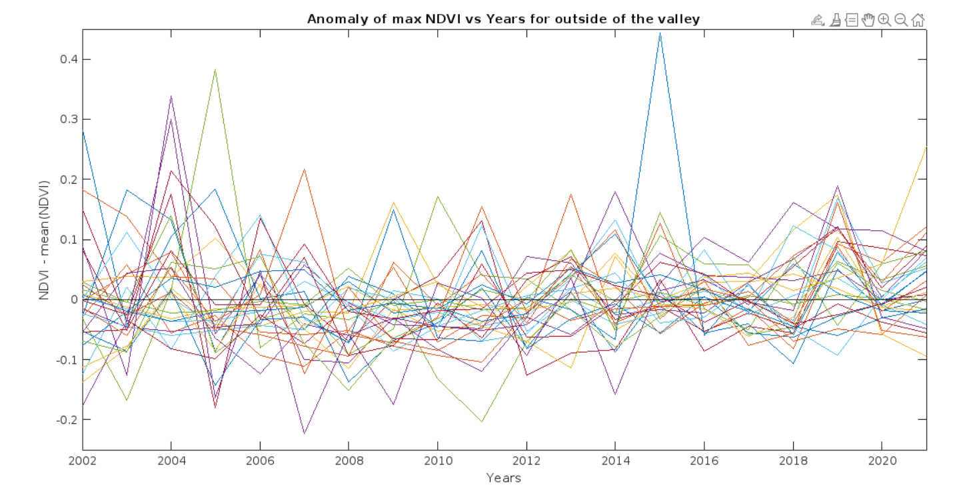
Figure 3

Slide 4
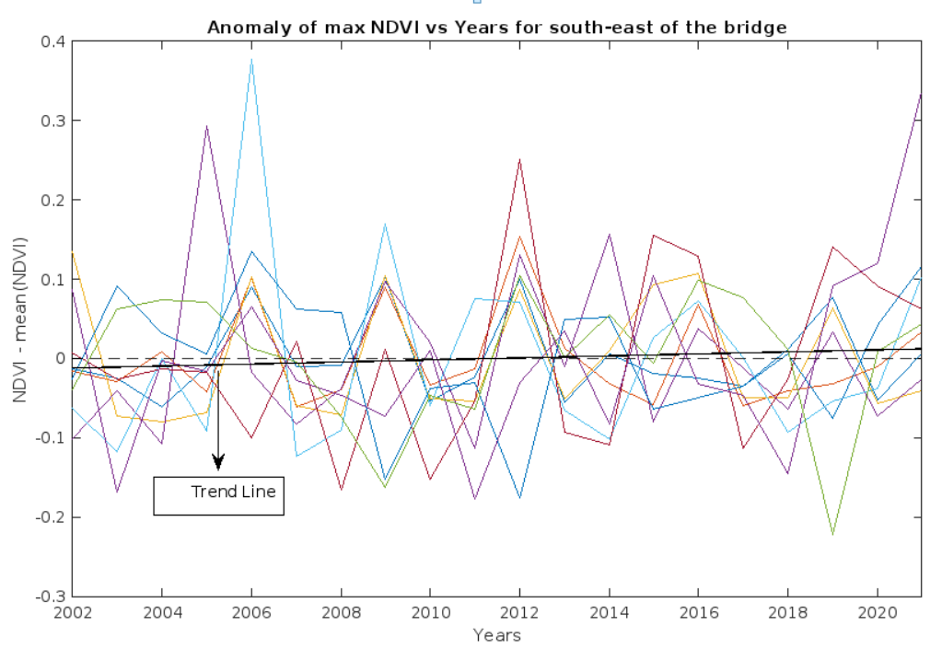
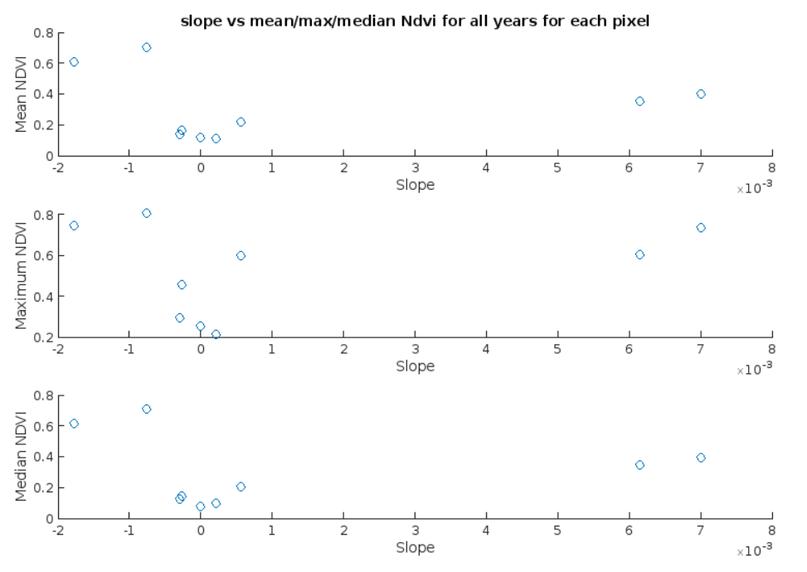
Figure 4 a
Figure 4 b

Slide 5
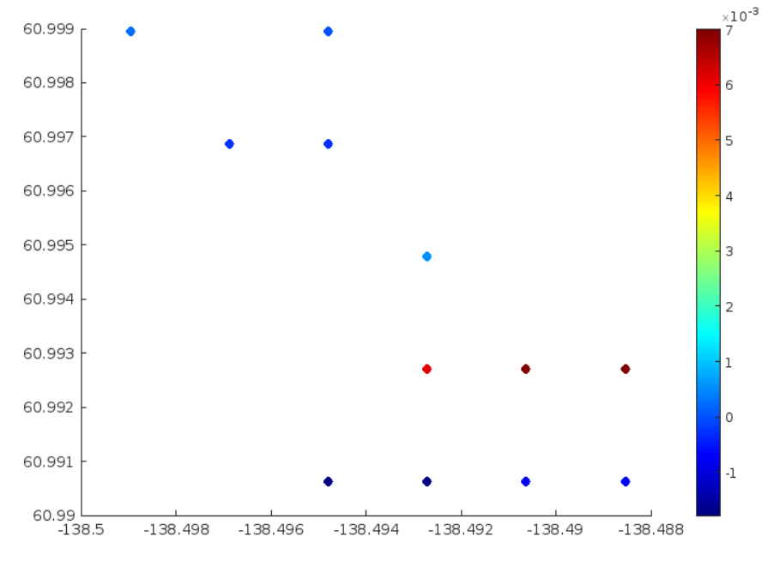
Figure 4 c

Slide 6
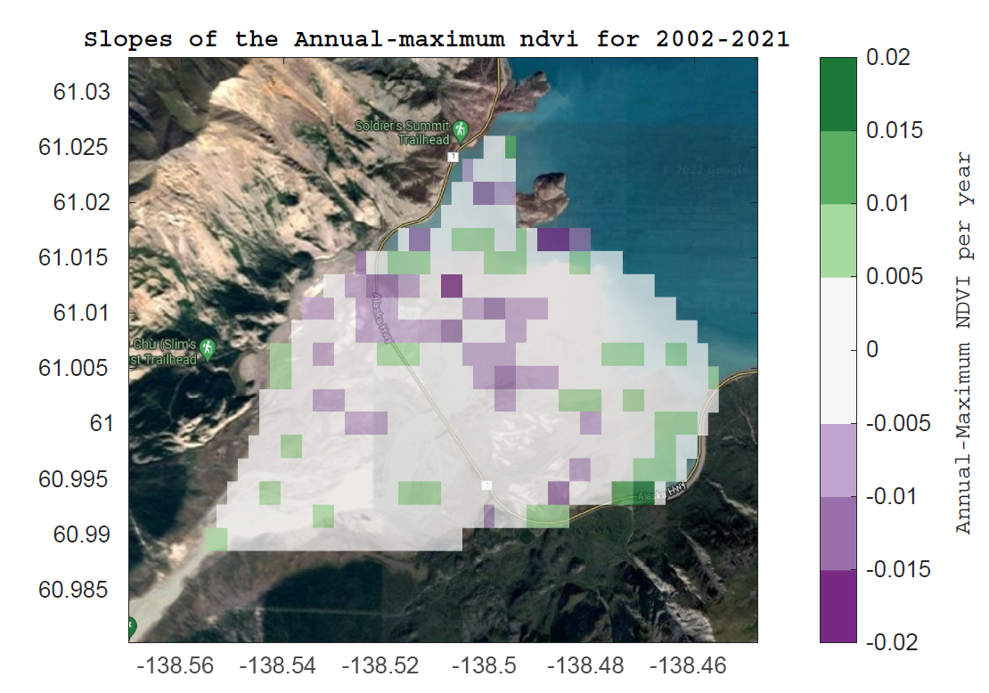
Figure 5
Code Location: Codes/Entire_year_NDVI/Surf_plot_slopes.mlx

Slide 7
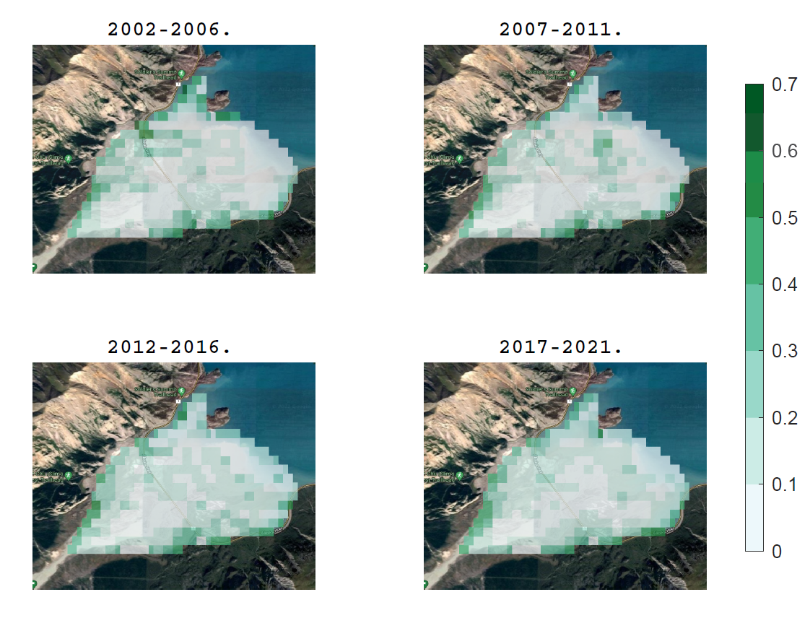
Annual-Maximum NDVI Values for 5 Year intervals
Figure 6
Code Location: Codes/Entire_year_NDVI/Surf_plot_panelof4.mlx

Slide 8
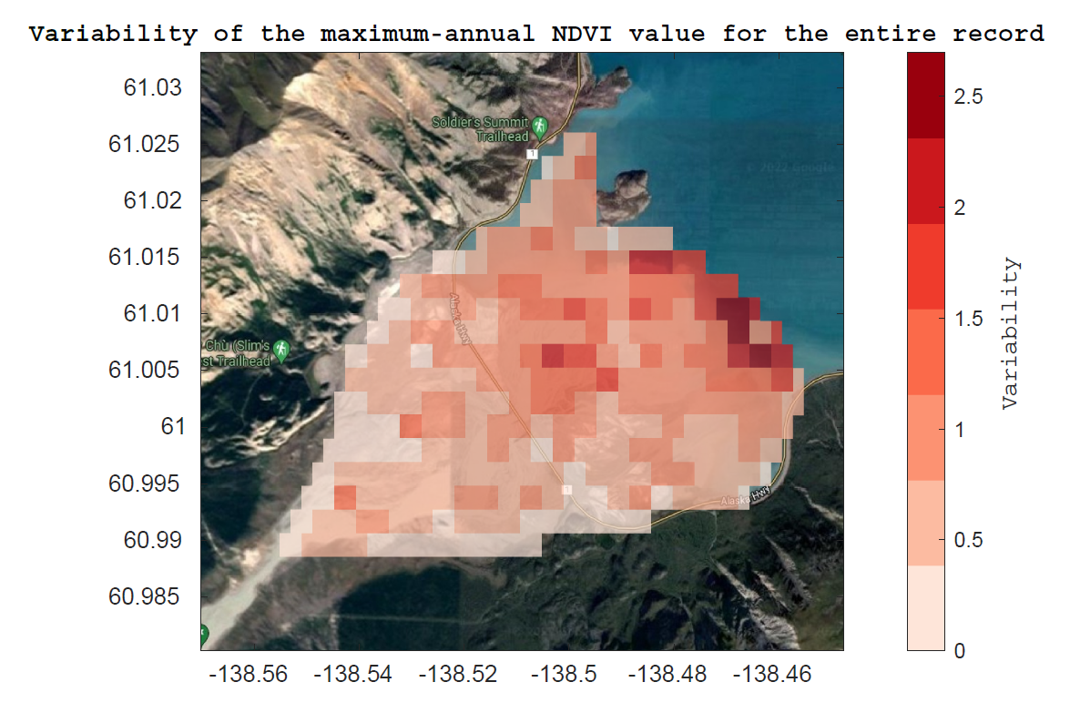
Figure 7
Code Location: Codes/Entire_year_NDVI/Variability.mlx

Slide 9
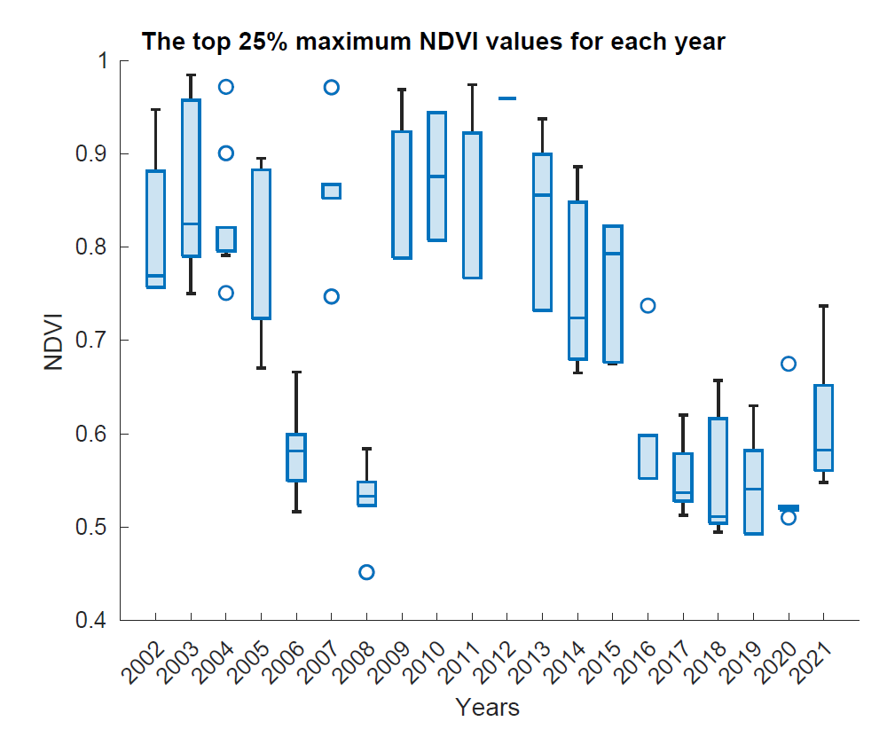
Figure 8.a
Code Location: Codes/Entire_year_NDVI/top_25_max_ndvi_boxchart.mlx

Slide 10
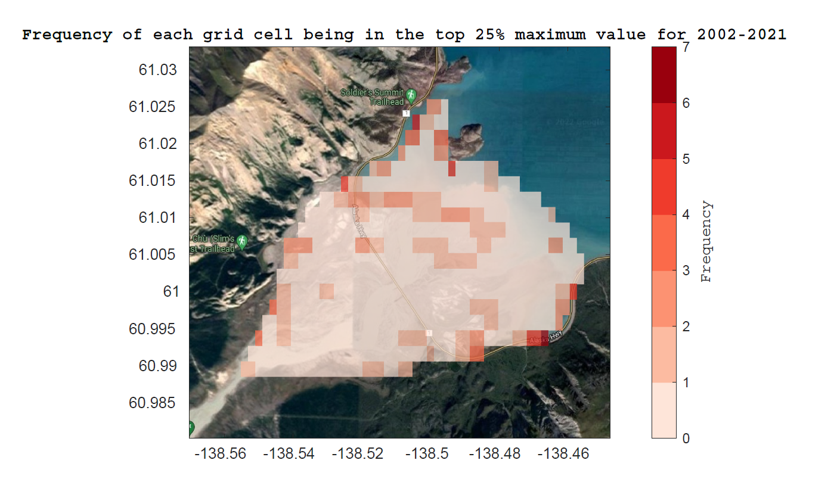
Figure 8.b
Code Location: Codes/Entire_year_NDVI/top_25_max_ndvi_boxchart.mlx

Slide 11
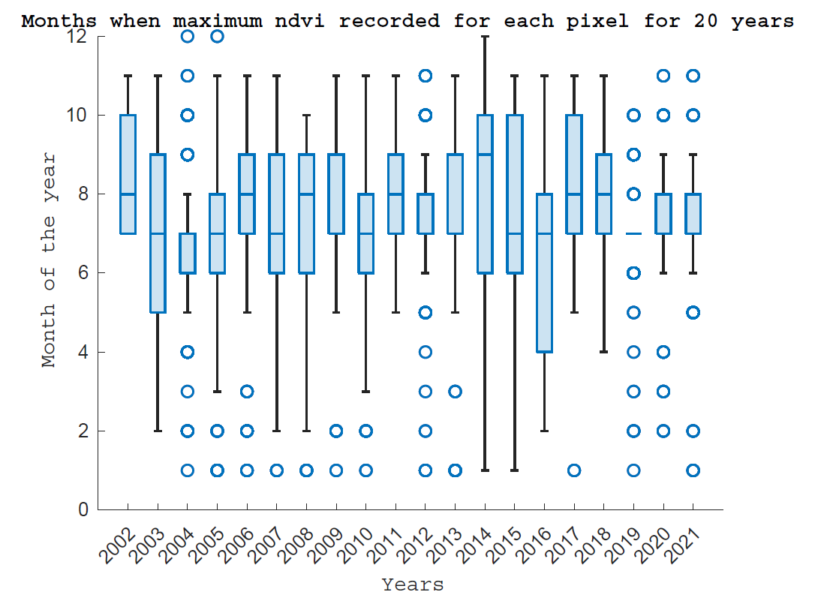
Figure 9.a
Code Location: Codes/Entire_year_NDVI/Month_of_max_ndvi.mlx

Slide 12
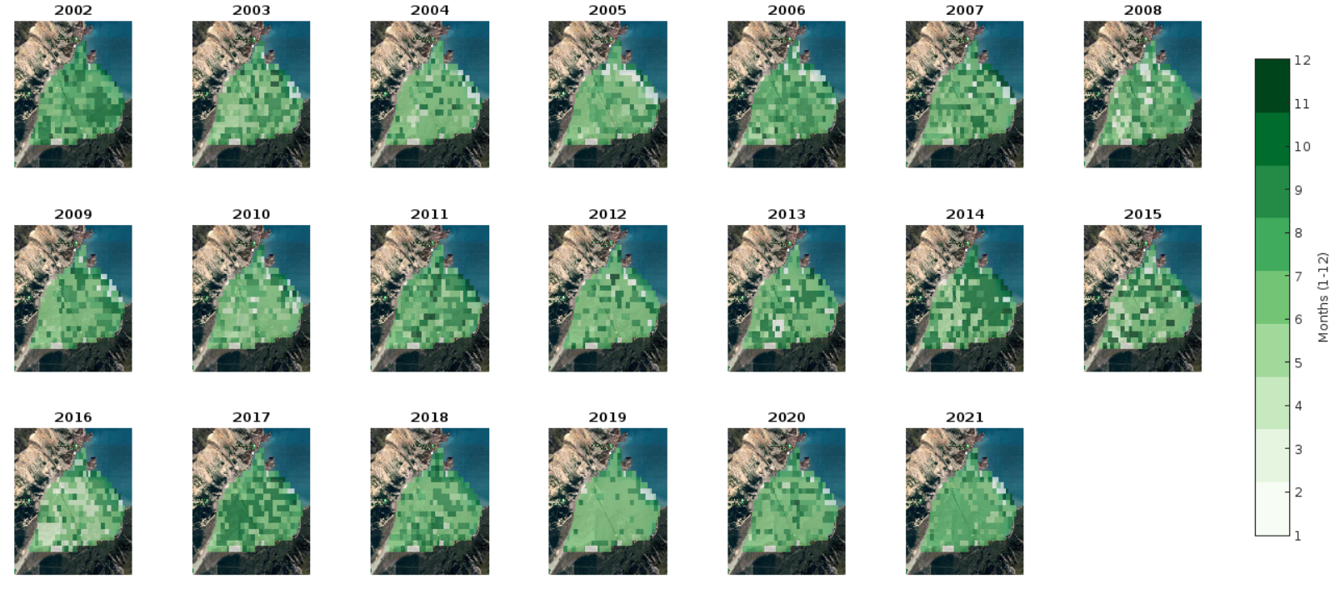
Figure 9.b
Code Location: Codes/Entire_year_NDVI/Month_of_max_ndvi.mlx

Slide 13
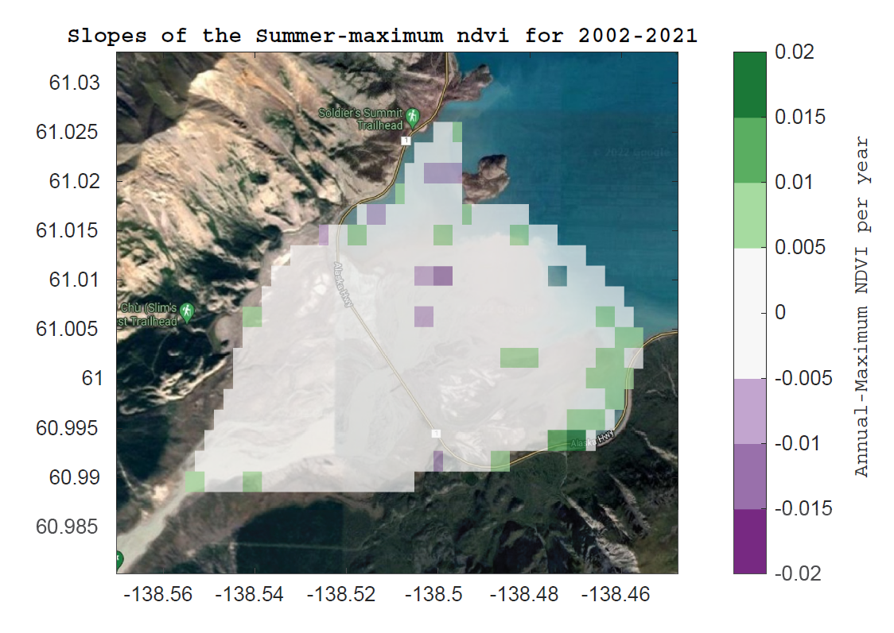
Figure 10
Code Location: Codes/Summer_NDVI/Plot_slopes_summer.mlx

Slide 14
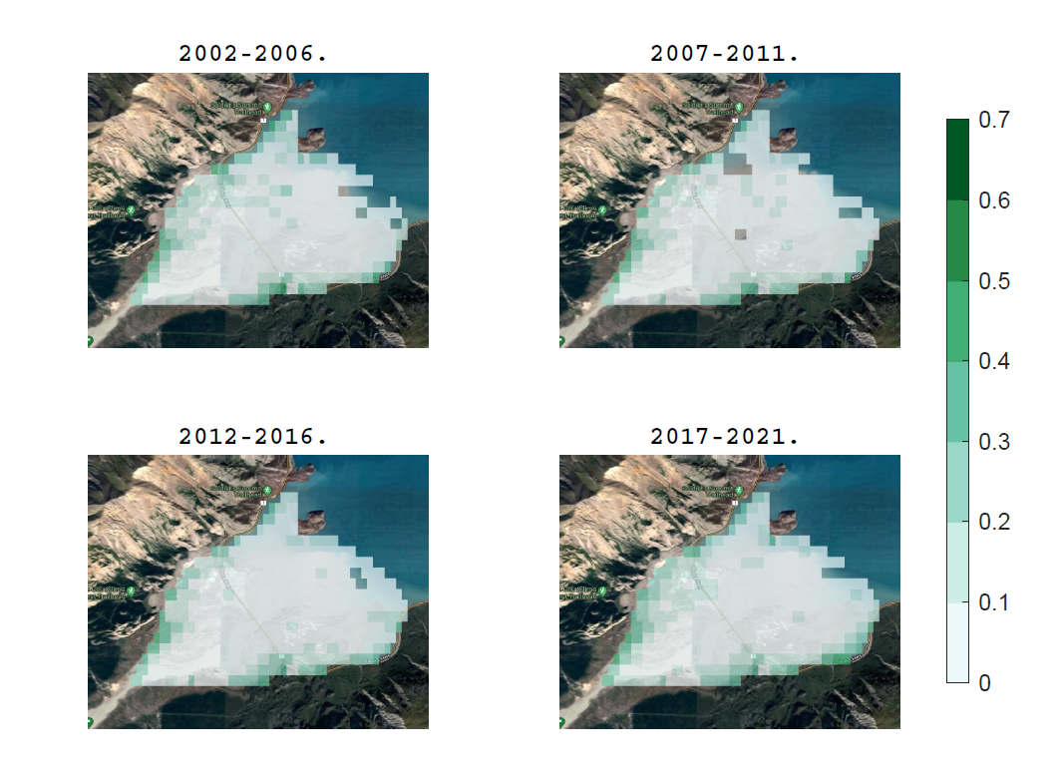
Figure 11
Code Location: Codes/Summer_NDVI/Plot_PanelOf4_Summer.mlx

Slide 15
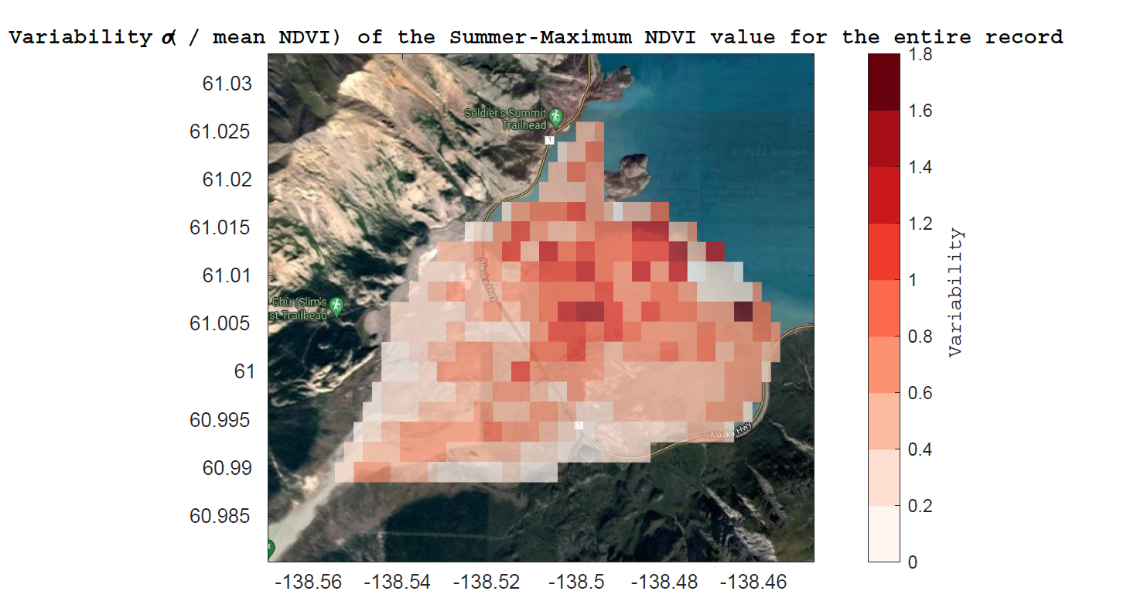
Figure 12
Code Location: Codes/Summer_NDVI/Plot_variability_Summer.mlx

Slide 16
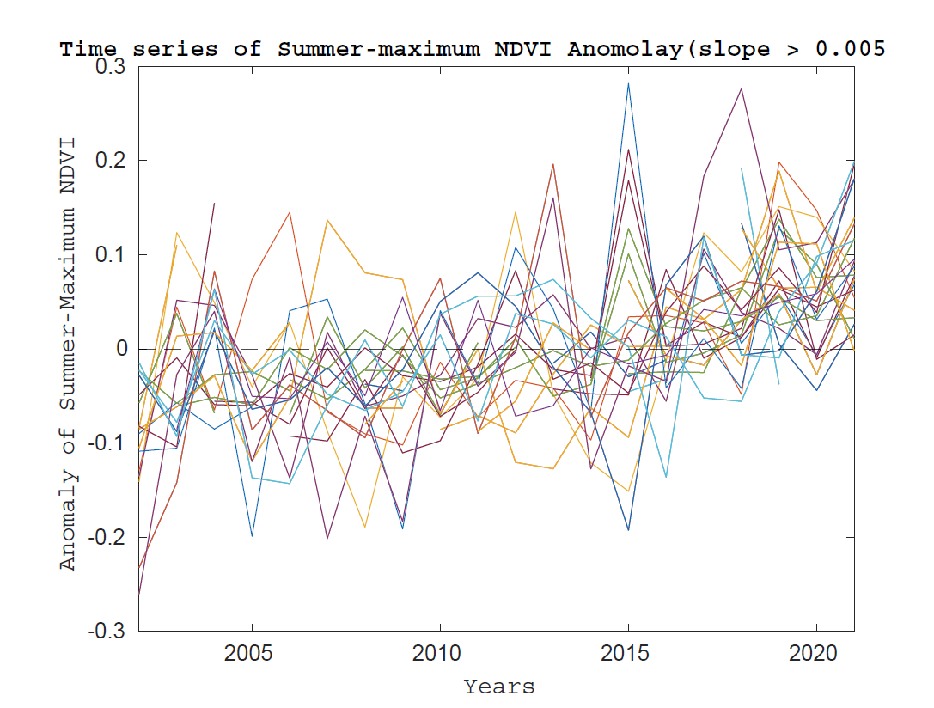
Figure 13.a
Code Location: Codes/Summer_NDVI/Positive_and_negative_slopes_Summer.mlx

Slide 17
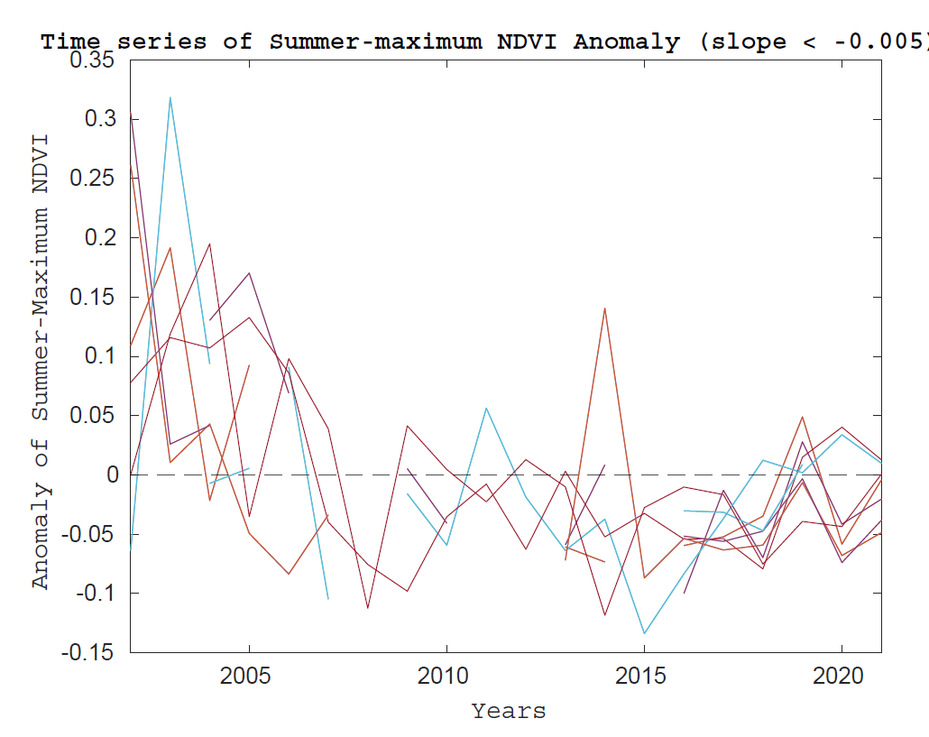
Figure 13.b
Code Location: Codes/Summer_NDVI/Positive_and_negative_slopes_Summer.mlx

Slide 18
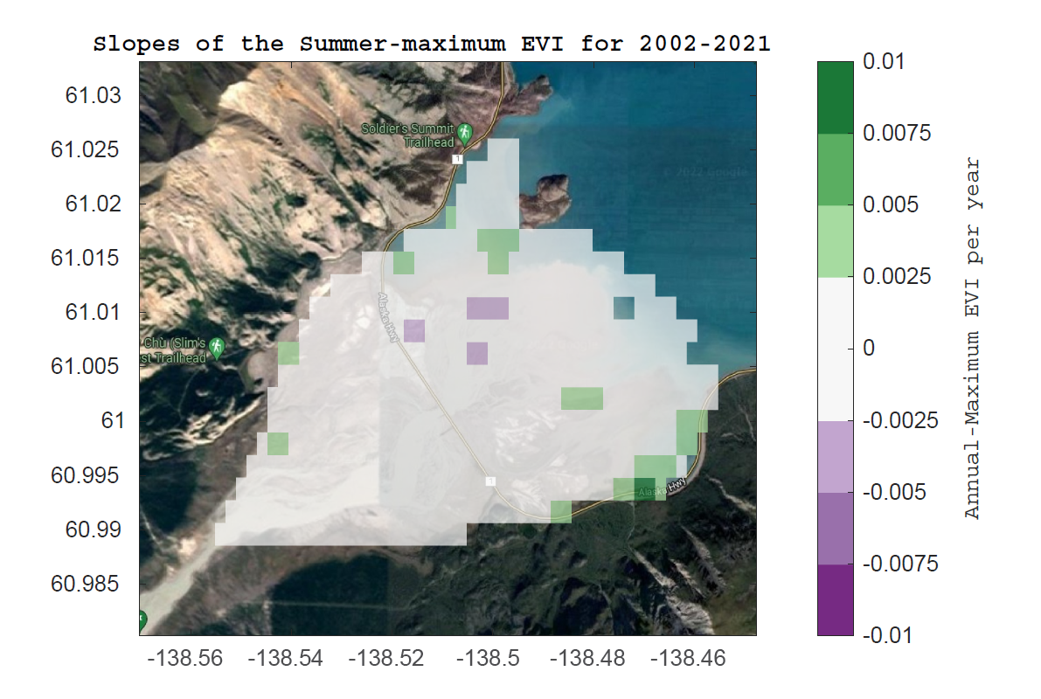
Figure 14
Code Location: Codes/Summer_EVI/Plot_slopes_summer.mlx

Slide 19
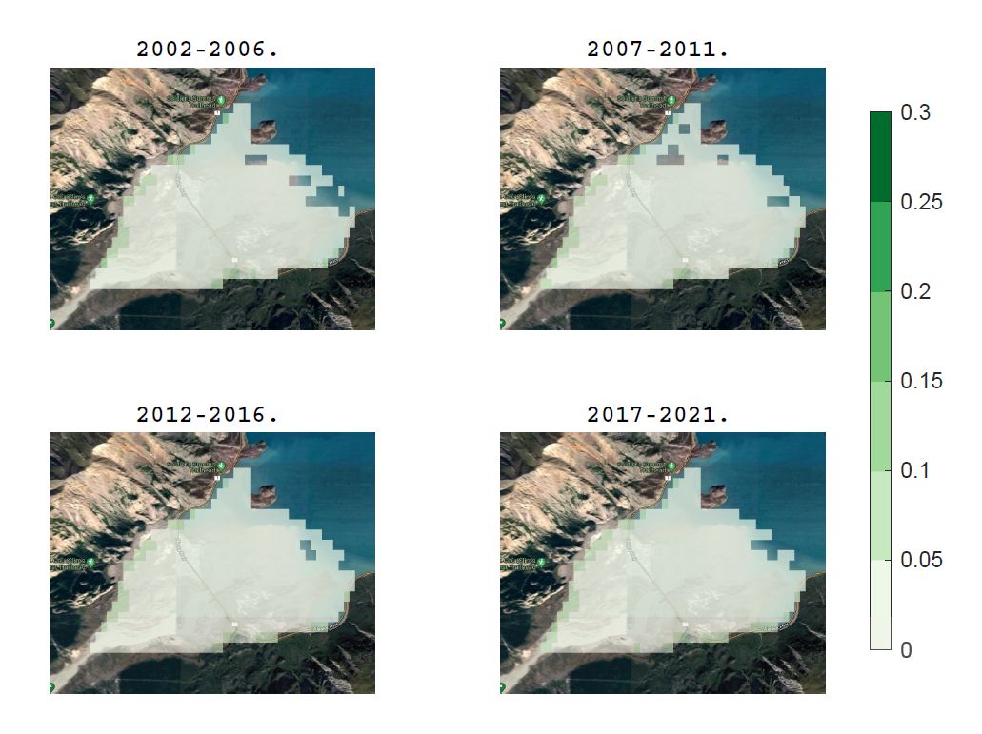
Figure 15
Code Location: Codes/Summer_EVI/Plot_PanelOf4_Summer.mlx

Slide 20
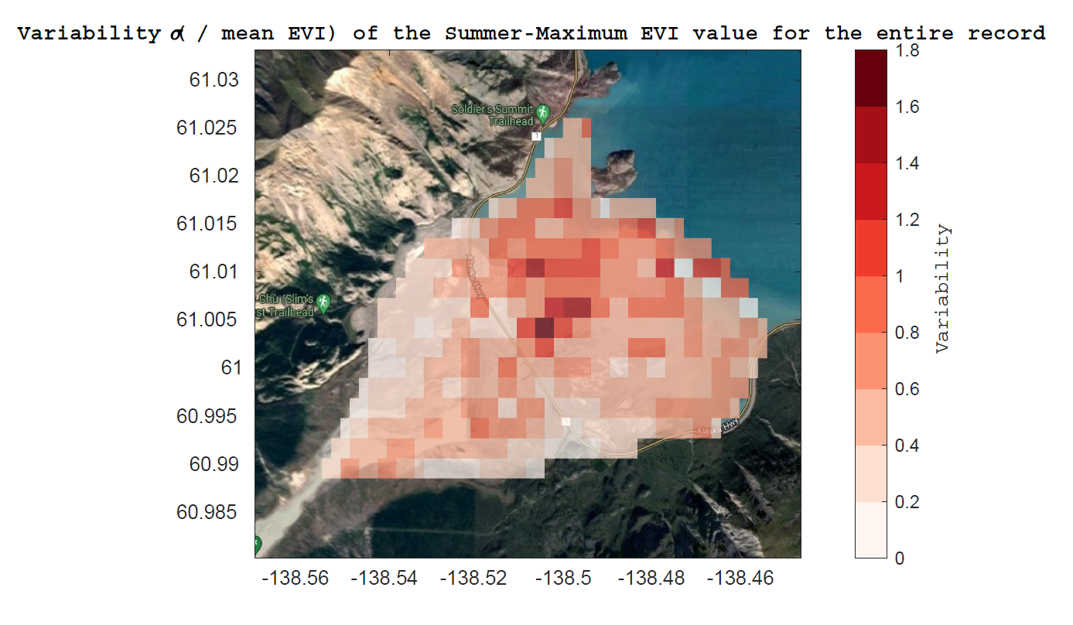
Figure 16
Code Location: Codes/Summer_EVI/Plot_variability_Summer.mlx

Slide 21
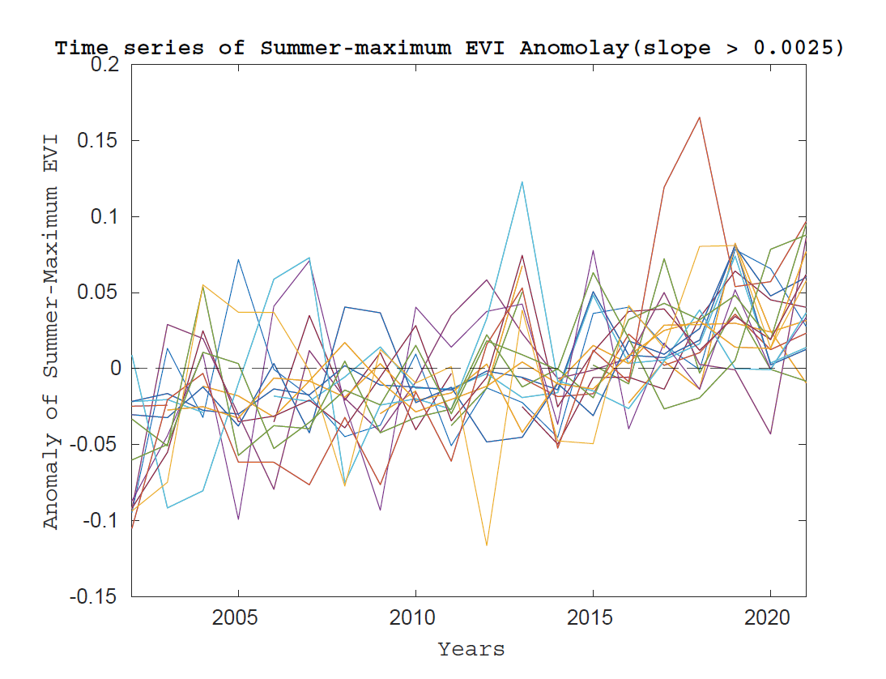
Figure 17.a
Code Location: Codes/Summer_EVI/Positive_and_negative_slopes_Summer.mlx

Slide 22
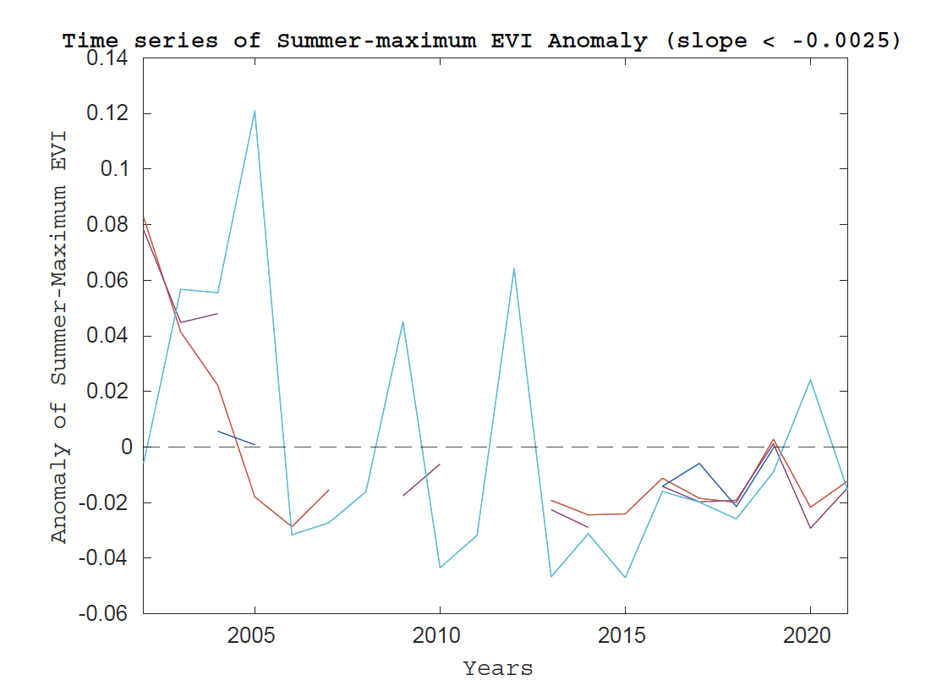
Figure 17.b
Code Location: Codes/Summer_EVI/Positive_and_negative_slopes_Summer.mlx

Slide 23
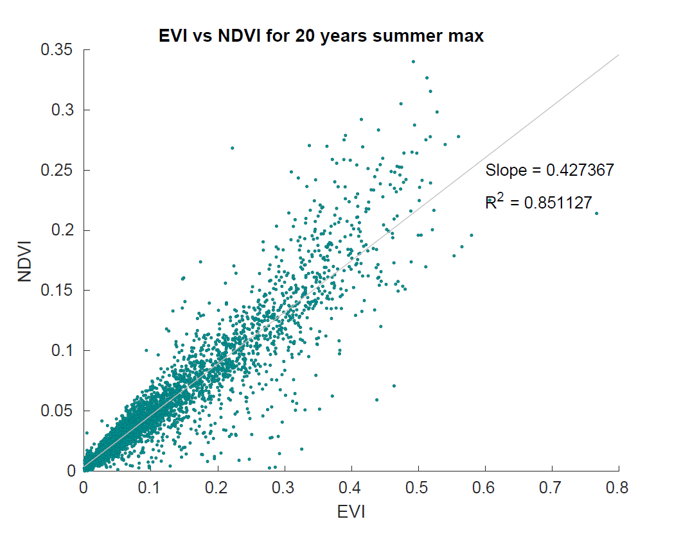
Figure 18
Code Location: Codes/Summer_EVI/NDVIvsEVI.mlx

Slide 24
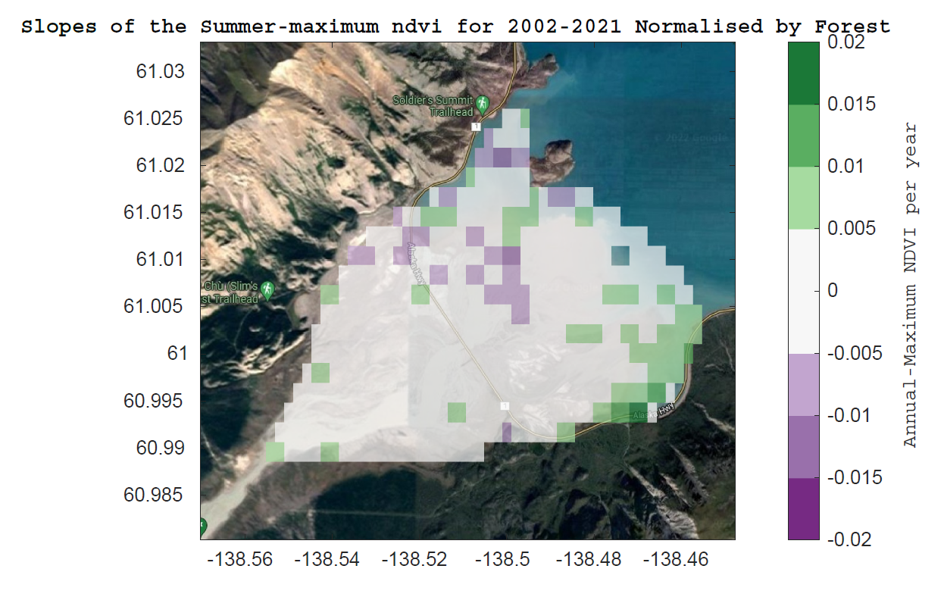
Figure 19
Code Location: Codes/Summer_Normalised_NDVI/Plot_slopes_summer_Normalised.mlx

Slide 25
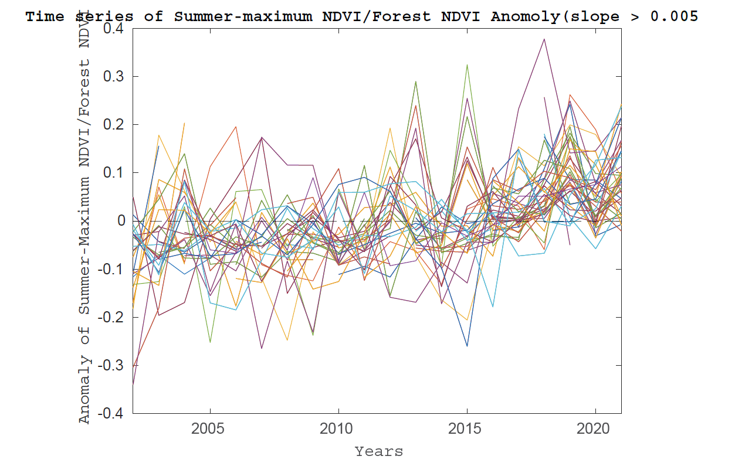
Figure 20
Code Location: Codes/Summer_Normalised_NDVI/Positive_and_negative_slopes_Summer_Normalised.mlx

Slide 26
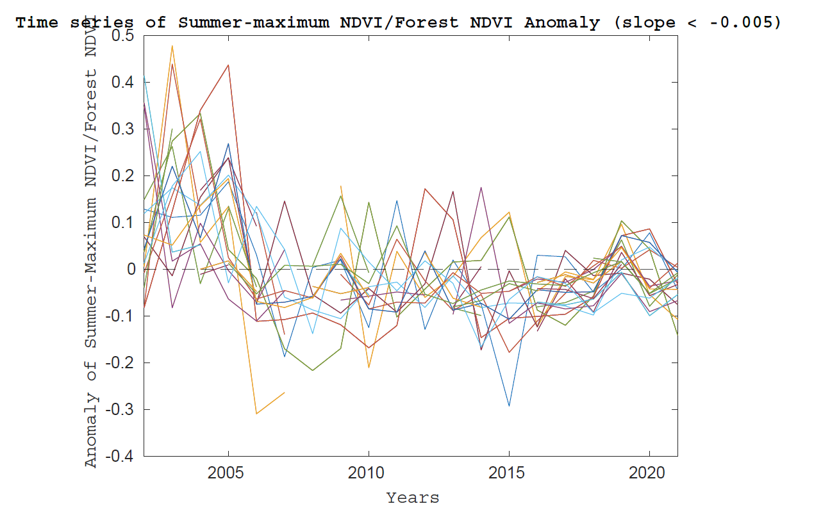
Figure 21
Code Location: Codes/Summer_Normalised_NDVI/Positive_and_negative_slopes_Summer_Normalised.mlx

Slide 27
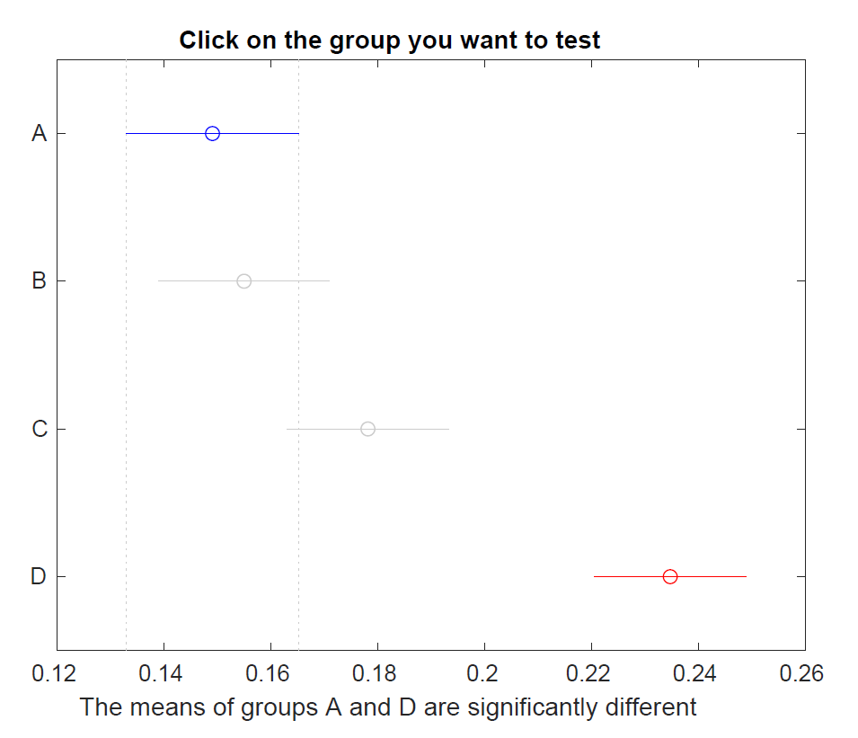
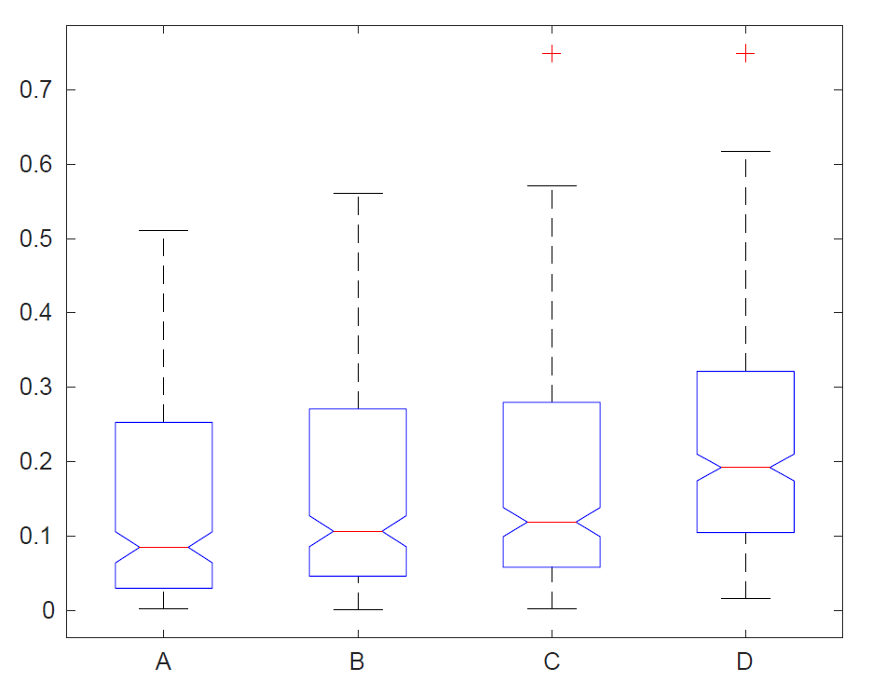
Anova1 test for positive slopes (slopes>0.005)
Figure 22.a
Code Location: Codes/Summer_Normalised_NDVI/Positive_and_negative_slopes_Summer_Normalised.mlx
Figure 22.b
Code Location: Codes/Summer_Normalised_NDVI/Positive_and_negative_slopes_Summer_Normalised.mlx

Slide 28
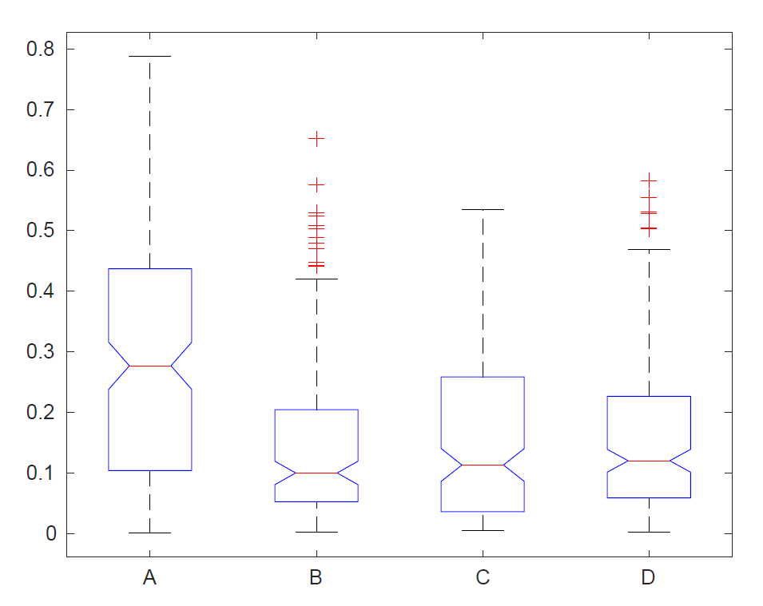
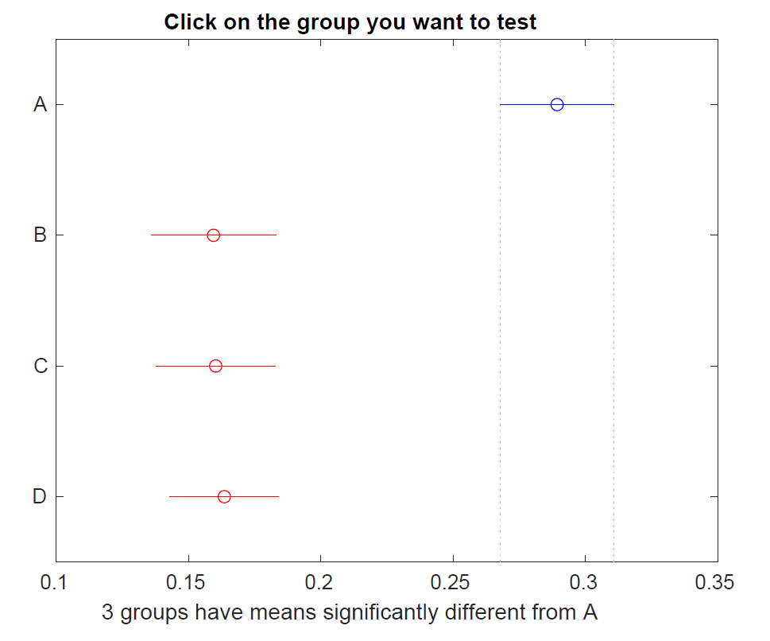
Anova1 test for Negative slopes (slopes< -0.005)
Figure 23.b
Code Location: Codes/Summer_Normalised_NDVI/Positive_and_negative_slopes_Summer_Normalised.mlx
Figure 23.a
Code Location: Codes/Summer_Normalised_NDVI/Positive_and_negative_slopes_Summer_Normalised.mlx

Slide 29
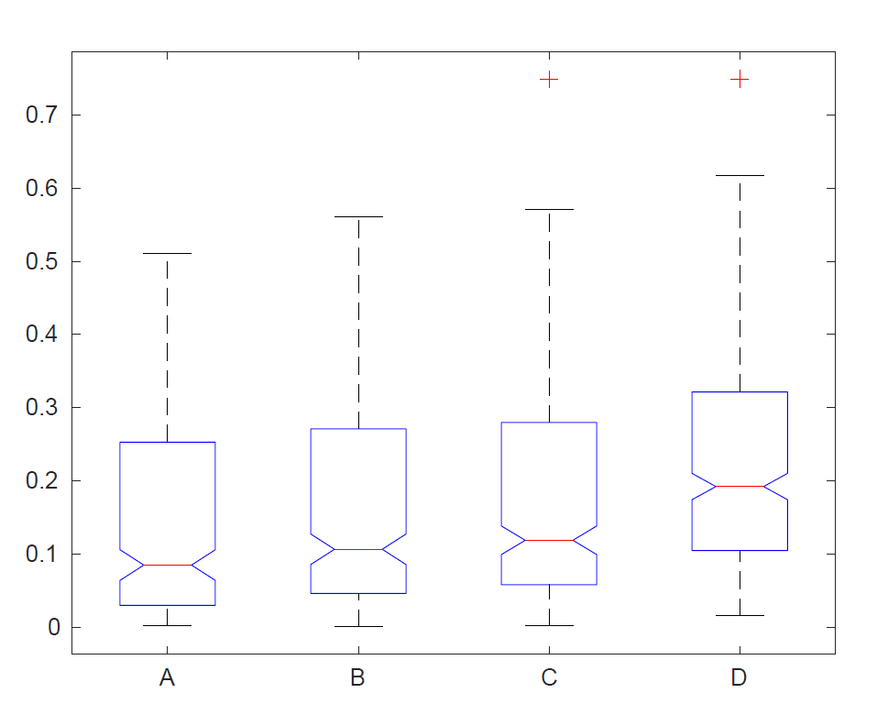
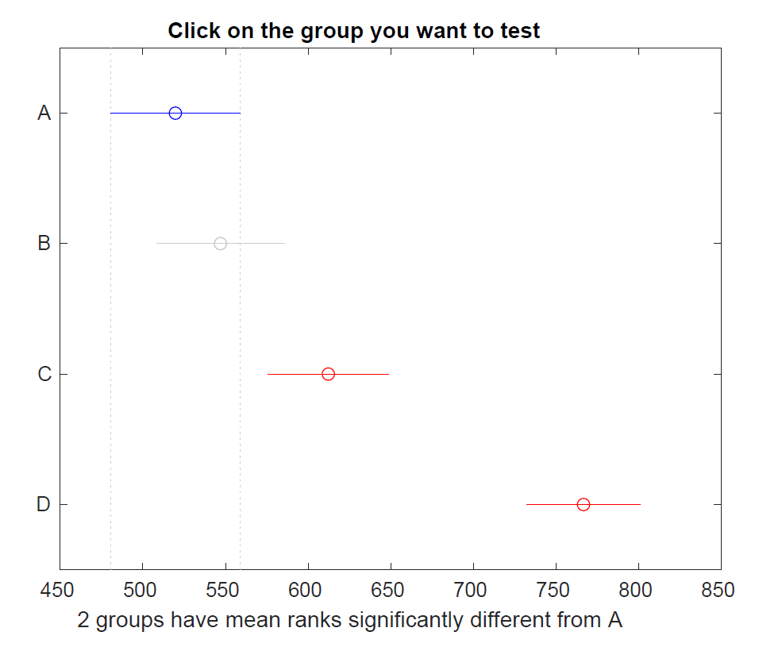
Kruskalwallis test for positive slopes (slopes>0.005)
Figure 24.a
Code Location: Codes/Summer_Normalised_NDVI/Positive_and_negative_slopes_Summer_Normalised.mlx
Figure 24.b
Code Location: Codes/Summer_Normalised_NDVI/Positive_and_negative_slopes_Summer_Normalised.mlx

Slide 30
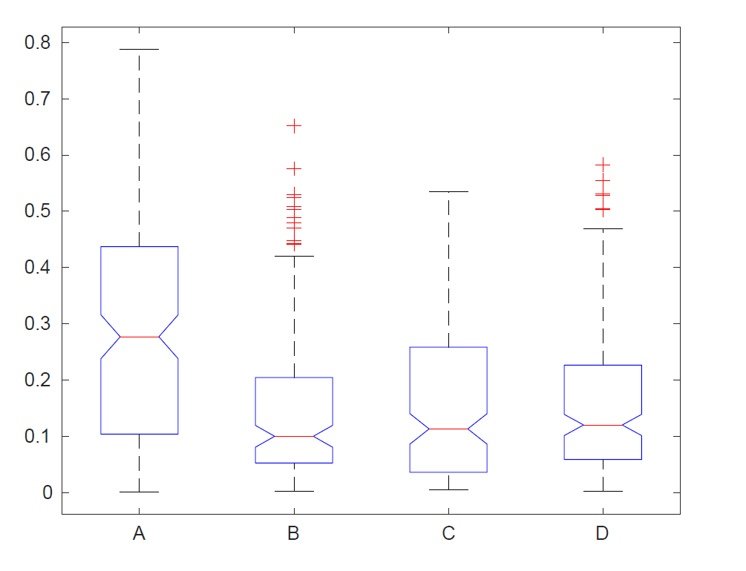
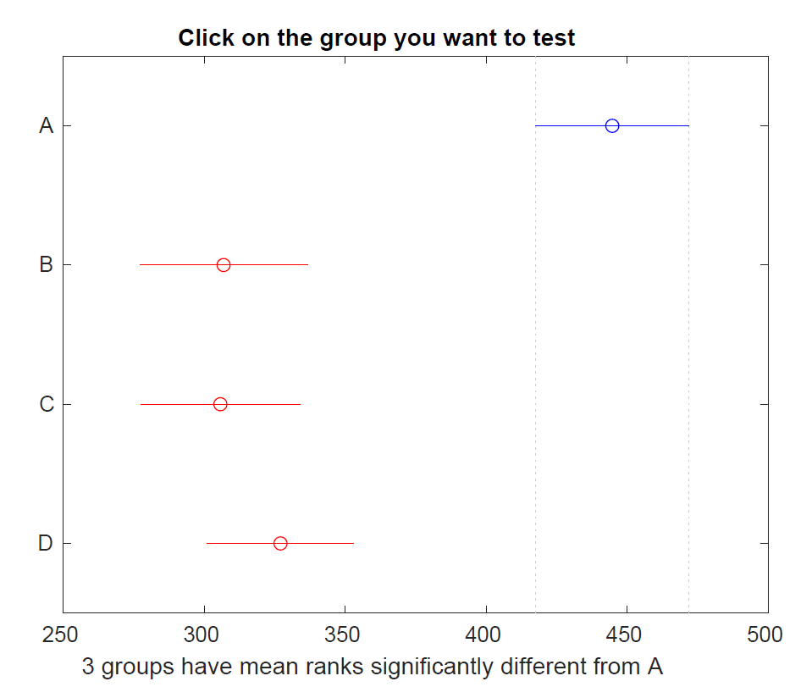
Kruskalwallis test for Negative slopes (slopes < -0.005)
Figure 25.a
Code Location: Codes/Summer_Normalised_NDVI/Positive_and_negative_slopes_Summer_Normalised.mlx
Figure 25.b
Code Location: Codes/Summer_Normalised_NDVI/Positive_and_negative_slopes_Summer_Normalised.mlx

